Slide 1



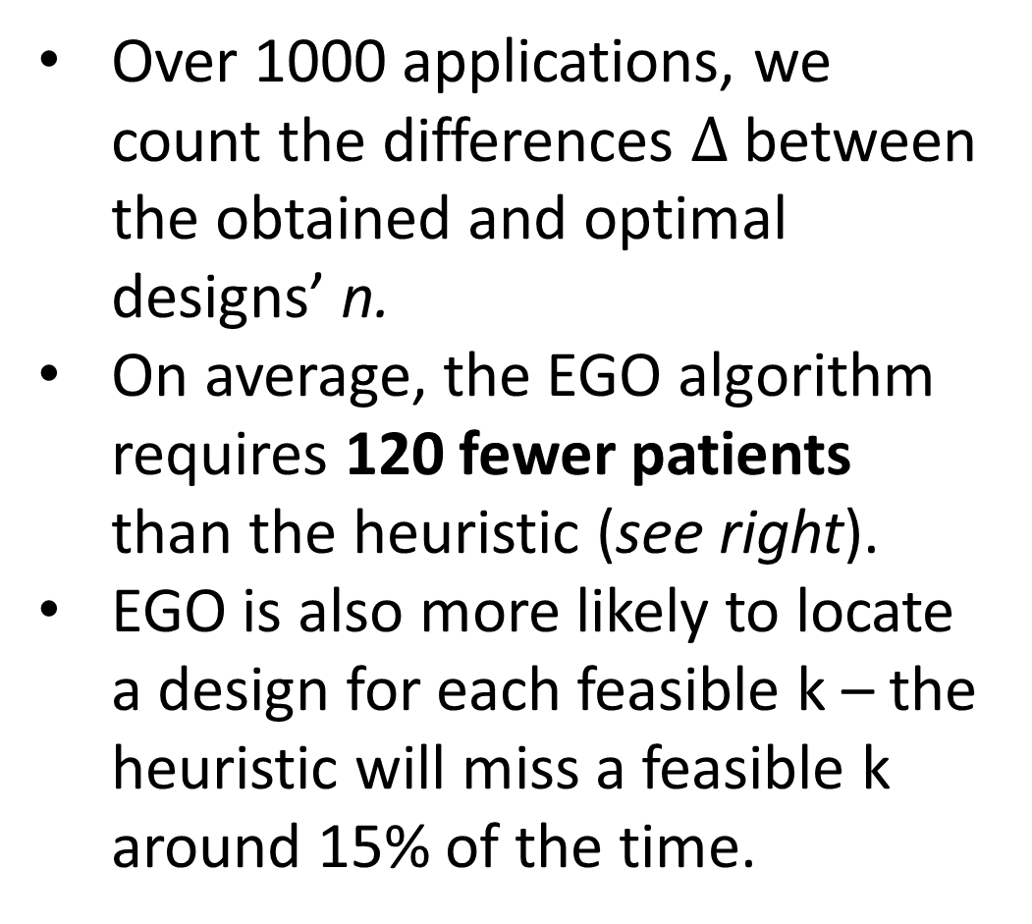
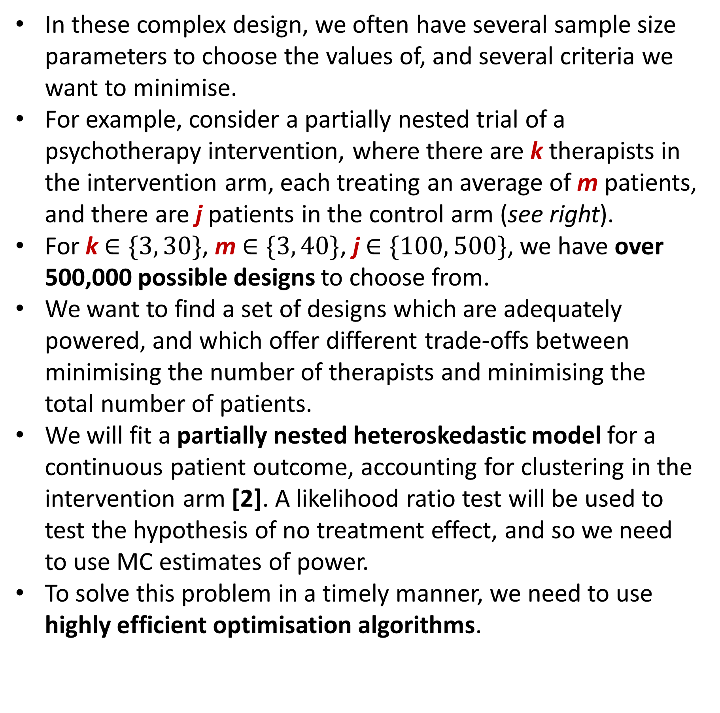
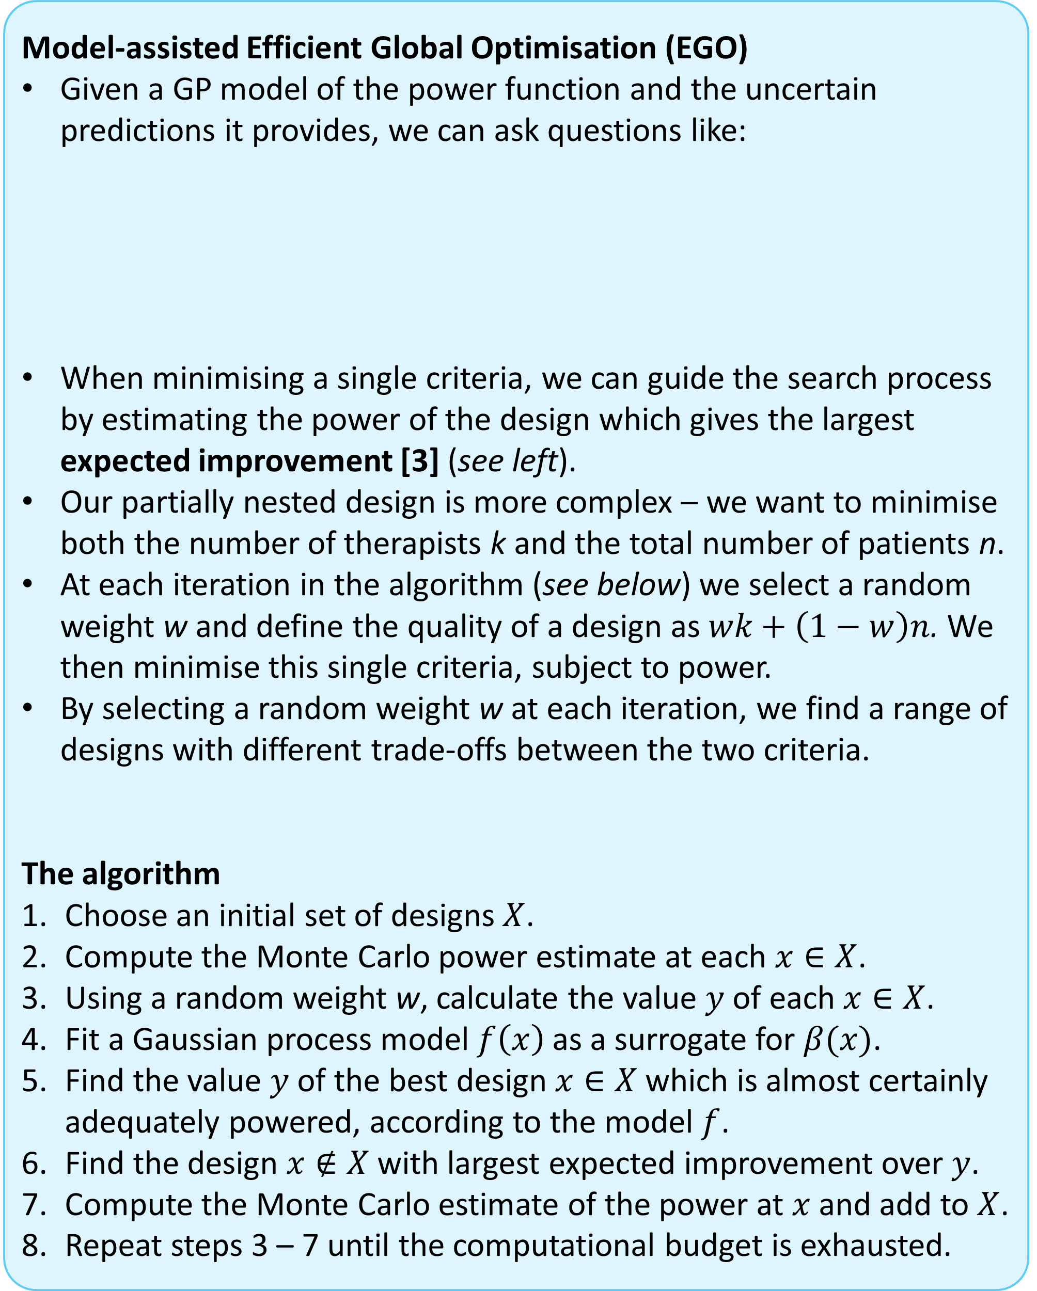
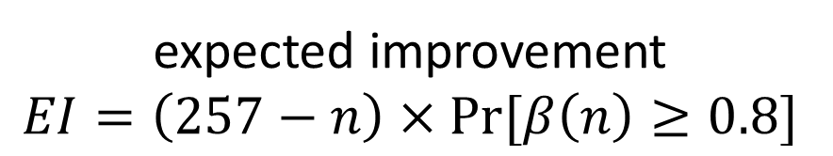
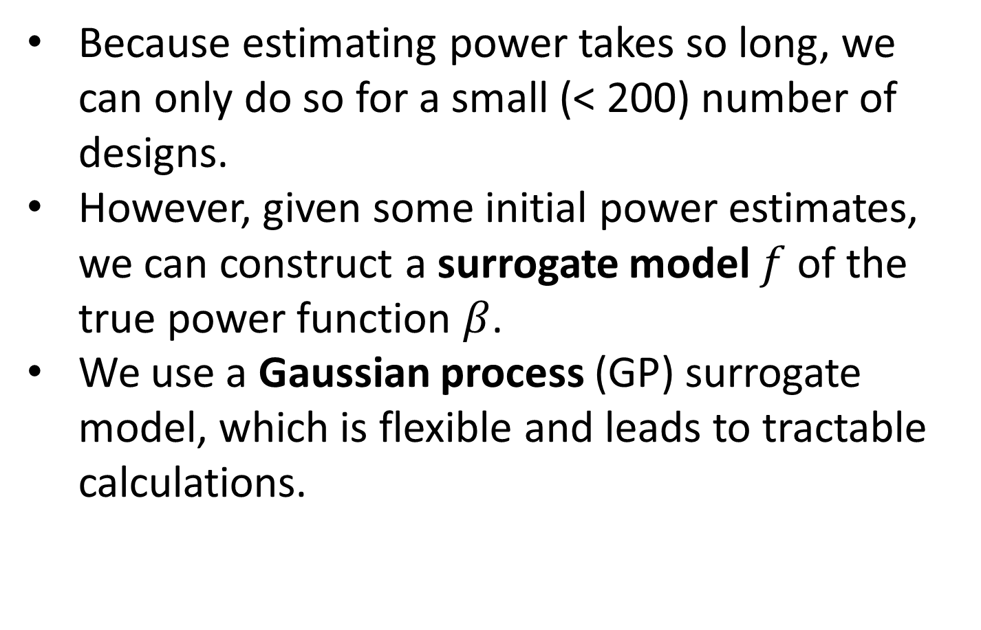


Sample size calculations using Bayesian optimisation
Duncan T. Wilsonª, Richard Hooper^{b}, Rebecca E. A. Walwynª, Sarah R. Brownª, Julia Brownª, Amanda J. Farrinª
a - Clinical Trials Research Unit, Leeds Institute of Clinical Trials Research, University of Leeds
b – Pragmatic Clinical Trials Unit, Blizard Institute, Queen Mary University of London
Background
For complex trial designs and analyses, simple analytic formulae for power calculations are not always available.
In such cases we can always fall back on Monte Carlo estimates of power, and use these when determining the optimal sample size [1].
This can be computationally demanding, requiring a considerable number of MC samples, N, to deliver a precise power estimate (see below).
In these complex design, we often have several sample size parameters to choose the values of, and several criteria we want to minimise.
For example, consider a partially nested trial of a psychotherapy intervention, where there are k therapists in the intervention arm, each treating an average of m patients, and there are j patients in the control arm (see right).
For k $∈\{3, 30\}$, m $∈\{3, 40\}$, j $∈\{100, 500\}$, we have over 500,000 possible designs to choose from.
We want to find a set of designs which are adequately powered, and which offer different trade-offs between minimising the number of therapists and minimising the total number of patients.
We will fit a partially nested heteroskedastic model for a continuous patient outcome, accounting for clustering in the intervention arm [2]. A likelihood ratio test will be used to test the hypothesis of no treatment effect, and so we need to use MC estimates of power.
To solve this problem in a timely manner, we need to use highly efficient optimisation algorithms.
Therapy
Treatment as usual
1.1
1
. . .
1
1.m
2
. . .
. . .
therapists
Estimated power
k.1
k
. . .
j
k.m
Methods
Log(N)
patients
Because estimating power takes so long, we can only do so for a small (< 200) number of designs.
However, given some initial power estimates, we can construct a surrogate model $f$ of the true power function $β$.
We use a Gaussian process (GP) surrogate model, which is flexible and leads to tractable calculations.
A GP model represents our belief about the power of a design through a normal distribution, giving both a point prediction (the mean) and a measure of the uncertainty in that prediction (see below).
GP models are commonly used in a wide variety of fields, and several R packages for fitting GPs are available.
Model-assisted Efficient Global Optimisation (EGO)
Given a GP model of the power function and the uncertain predictions it provides, we can ask questions like:
When minimising a single criteria, we can guide the search process by estimating the power of the design which gives the largest expected improvement [3] (see left).
Our partially nested design is more complex – we want to minimise both the number of therapists k and the total number of patients n.
At each iteration in the algorithm (see below) we select a random weight w and define the quality of a design as $wk+\left(1−w\right)n$. We then minimise this single criteria, subject to power.
By selecting a random weight w at each iteration, we find a range of designs with different trade-offs between the two criteria.
The algorithm
Choose an initial set of designs $X$.
Compute the Monte Carlo power estimate at each $x∈X$.
Using a random weight w, calculate the value $y$ of each $x∈X$.
Fit a Gaussian process model $f\left(x\right)$ as a surrogate for $β(x)$.
Find the value $y$ of the best design $x∈X$which is almost certainly adequately powered, according to the model $f$.
Find the design $x∉X$with largest expected improvement over $y$.
Compute the Monte Carlo estimate of the power at $x$ and add to $X$.
Repeat steps 3 – 7 until the computational budget is exhausted.
If I estimate the power of a new design, what is the probability that it will be sufficient?
Compared with the best design I have found so far, what improvement can I expect to see if I estimate the power of this new design?
Predicted power at
n = 183
evaluated designs
GP uncertainty
best current design, n = 257
power
GP mean
function
expected improvement
$$EI=\left(257−n\right)×Pr⁡[β\left(n\right)≥0.8]$$
Illustration
sample size n
We used the EGO method to determine sample size for the above partially nested psychotherapy example. For comparison, we also used a simple heuristic. The two methods are contrasted here.
EGO
Heuristic
In a single application, we compared the performance of EGO and the heuristic.
The EGO algorithm finds more efficient designs – for equal numbers of therapists, EGO designs can require as many as 220 fewer patients, a reduction of around 20%.
The EGO designs are quite close to the optimal designs (see left).
Over 1000 applications, we count the differences $Δ$between the obtained and optimal designs’ n.
On average, the EGO algorithm requires 120 fewer patients than the heuristic (see right).
EGO is also more likely to locate a design for each feasible k – the heuristic will miss a feasible k around 15% of the time.
therapists
$$Δ$$
optimal designs
References
patients
$$Δ$$
[1] Landau, S. & Stahl, D. (2013), Sample size and power calculations for medical studies by simulation when closed form expressions are not available, Statistical Methods in Medical Research, 22, 324-345. [2] Roberts, C. & Roberts, S. A. (2005), Design and analysis of clinical trials with clustering effects due to treatment, Clinical Trials, 2, 152-162. [3] Jones, D. R. (2001), A Taxonomy of Global Optimization Methods Based on Response Surfaces, Journal of Global Optimization, 21, 345-383.
Acknowledgements
Duncan Wilson is funded by an MRC Skills Development Fellowship

